Slide 1

FINAL YEAR PROJECT
KutumbSetu
(कुटुम्बसेतु)
A Smart Community Management System
TEAM
Rishik Jariwala | Nirmay Patel | Rishi Soni
Group:10
PROJECT GUIDE
Mr. Pankaj D. Rathod
COLLEGE
SVKM's Shri Bhagubhai Mafatlal Polytechnic
ACADEMIC YEAR
સમસ્ત દરજી સમાજ બાબરિયાવાડ
2026 – 27

Slide 2




The Challenges of Community Management
02 | PROBLEM STATEMENT
Communities still run on group chats, paper registers and phone calls.
Scattered communication
Manual event management
Announcements, wishes and notices are spread over many chat groups, so members miss updates.
Events and registrations are handled by hand, with no single list of who is attending.
For a Community with 250+ families spread across villages and cities, this patchwork means missed announcements, duplicated effort and outdated records.
Unorganised resident data
No central access to services
Member details sit in notebooks and sheets that are hard to search, update or trust.
Directory, family records, matrimony and events live in different places.

Slide 3
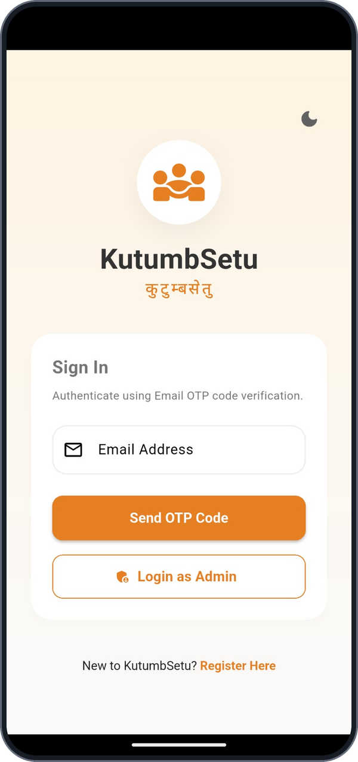
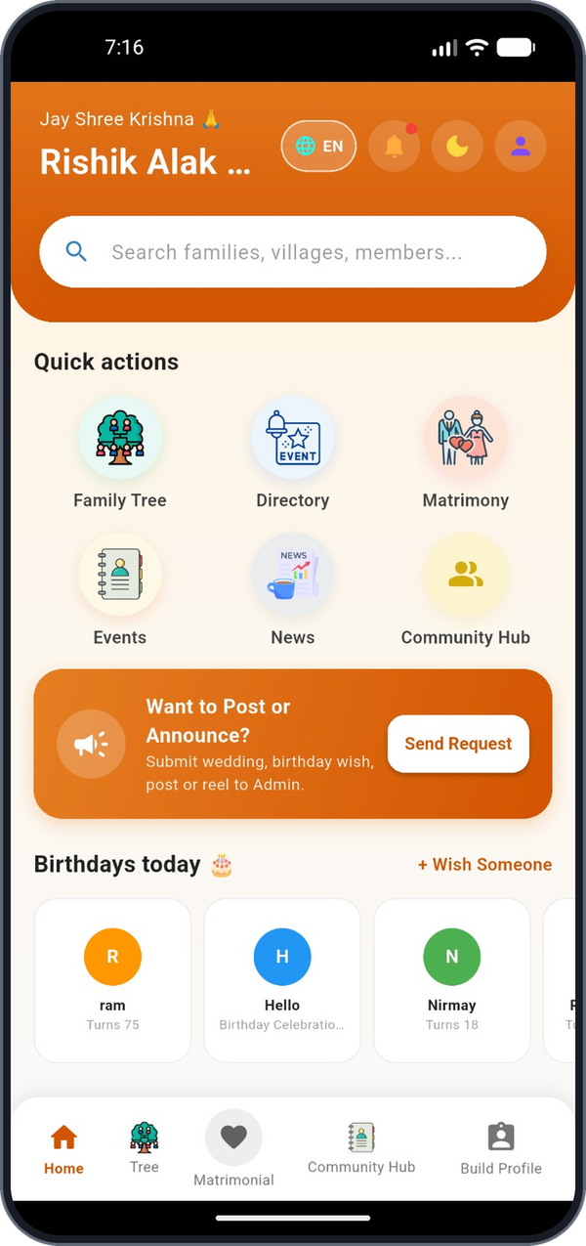





Introducing KutumbSetu
03 | PROPOSED SOLUTION
One mobile platform that brings the whole community, its events and its records together.
Unified mobile application
Family tree, directory, events, news and matrimony in one app
Secure user authentication
Email OTP sign-in, plus a separate admin login
Centralised community information
Member profiles and records stored in one database
Organised event participation
Browse campaigns, register and get a unique ID
A convenient user experience
Simple screens, English/regional language and dark mode
Email OTP sign-in
Home dashboard

Slide 4
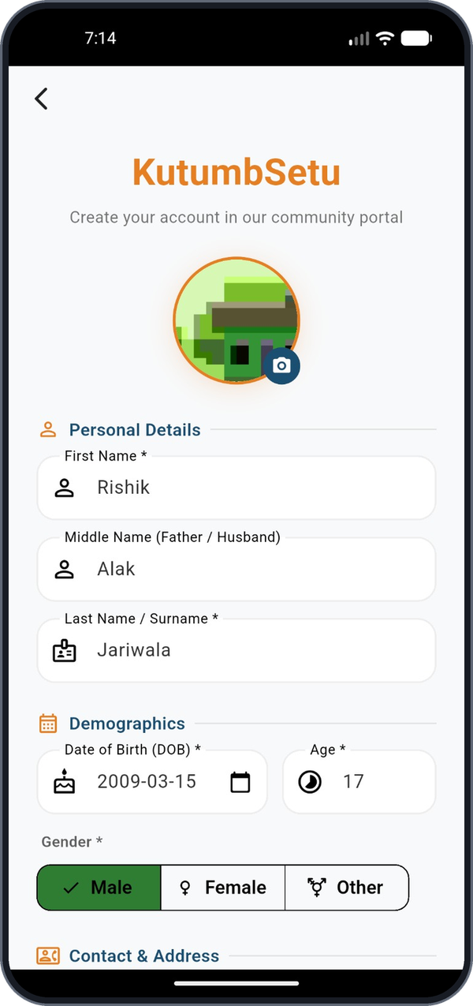
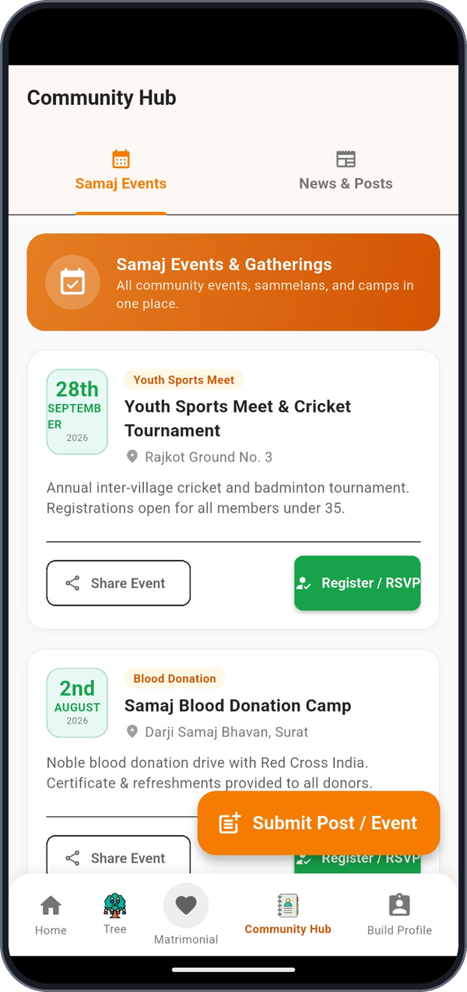






Core Features and Functionalities
04 | KEY FEATURES
Email OTP login
Passwordless sign-in verified by a one-time code
Registration & profile
Photo, personal, demographic and contact details
Event & campaign listing
Community events with date, venue and RSVP button
Participant & volunteer role
Choose how to join and how many people
Emergency contact
Emergency person and special requests captured
Admin management
Review registrations and update their status
Also built: Family Tree | Directory | Matrimony | Birthday wishes | Multilingual | Dark mode
Registration & profile
Event listing

Slide 5

How KutumbSetu Works
05 | SYSTEM ARCHITECTURE
Flutter App
Dart mobile interface
HTTPS / REST (JSON)
Node.js / Express
Backend and API logic
Read / write queries
MongoDB
Persistent data storage
Single Dart codebase for the user app and the admin console: forms, navigation, dark mode and language switch.
REST endpoints for authentication, profiles, events and registrations. Validates input and applies the rules.
Stores users, family links, events and every registration record created in the app.
Email OTP verification workflow
1
User enters email address
2
API generates an OTP and emails it
3
User types the code in the app
4
API verifies the code
5
Session starts for user or admin

Slide 6


Technologies and Tools Used
06 | TECHNOLOGY STACK
Frontend
Cross-platform mobile UI
Flutter
Dart
Backend
API and business logic
Node.js
Express.js
REST API
Database
Flexible document storage
MongoDB
Testing
UI and API verification
Appium
API testing tools
DevOps
Versioning, containers, deployment
Git / GitHub
Docker
Docker Compose
Ansible
AWS EC2

Slide 7
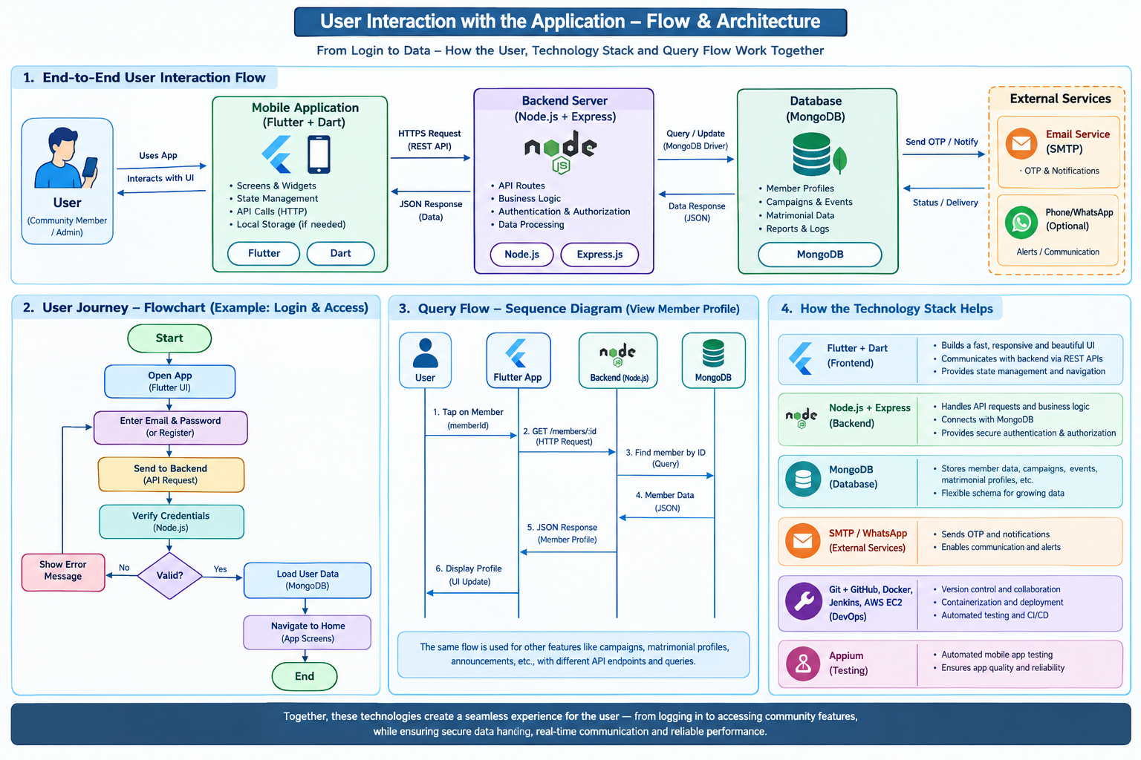
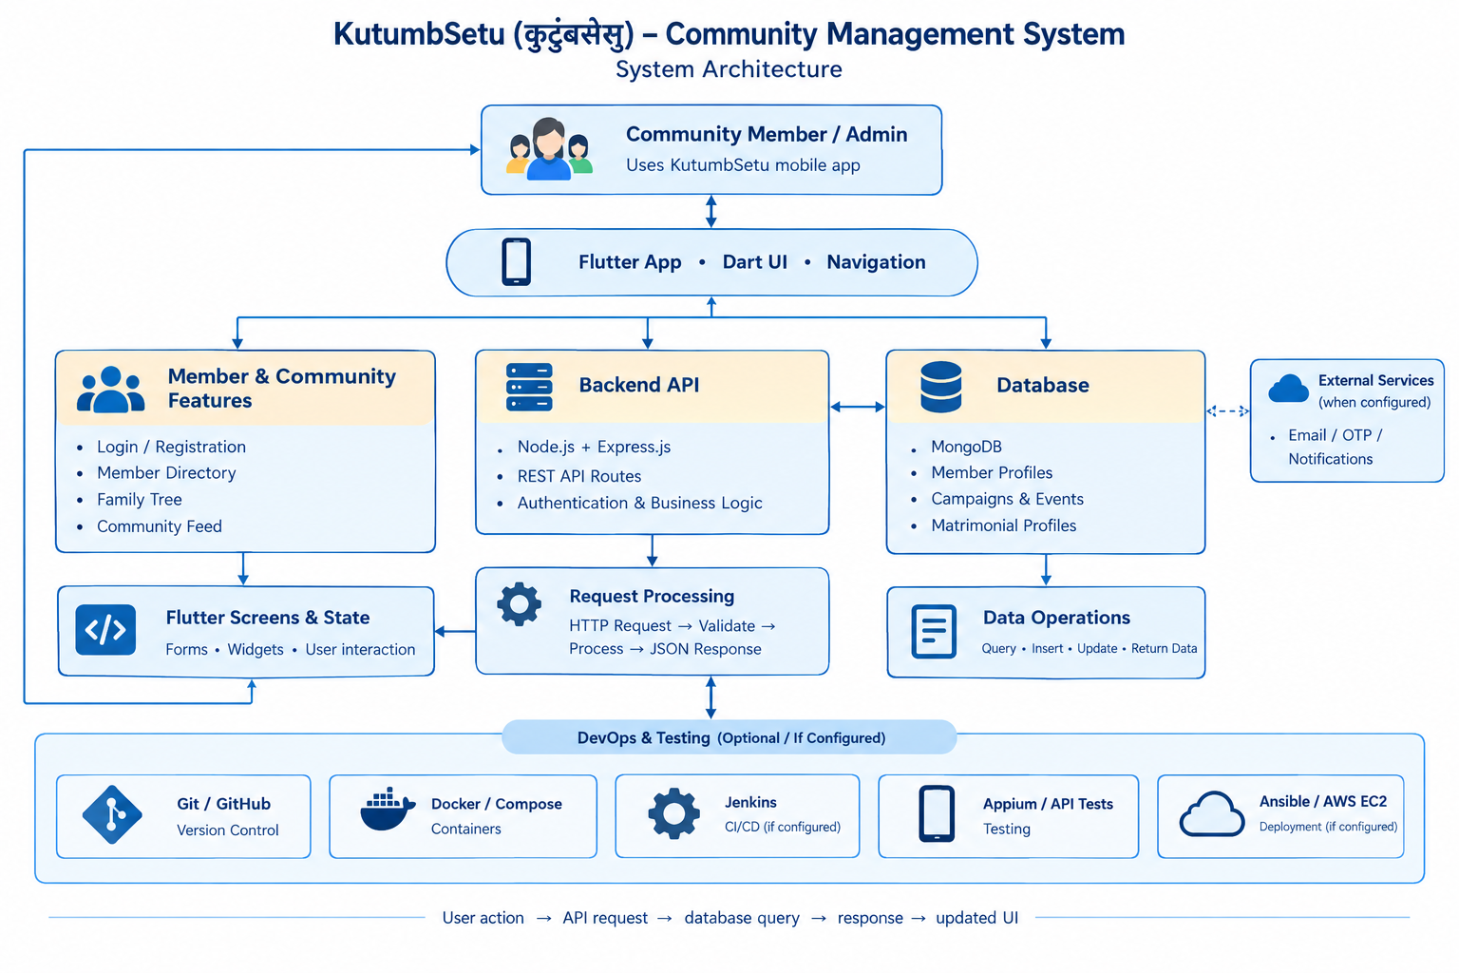
How a sample user interacts with the Application

Slide 8
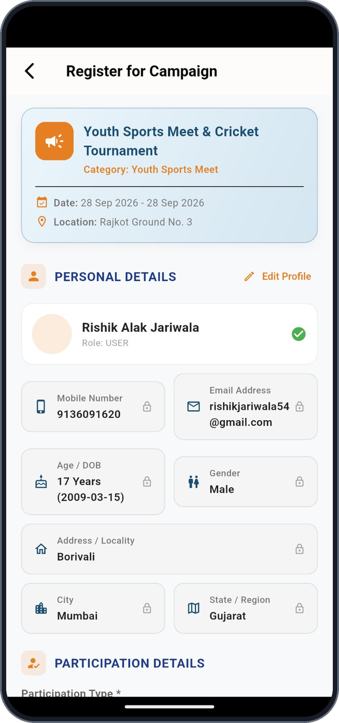
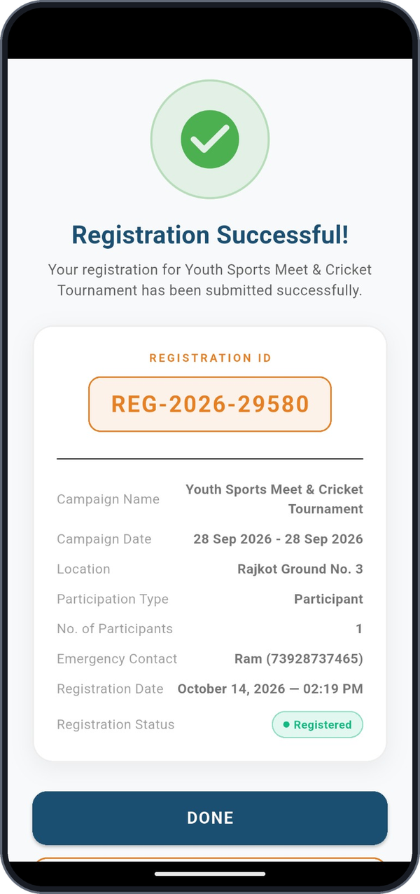
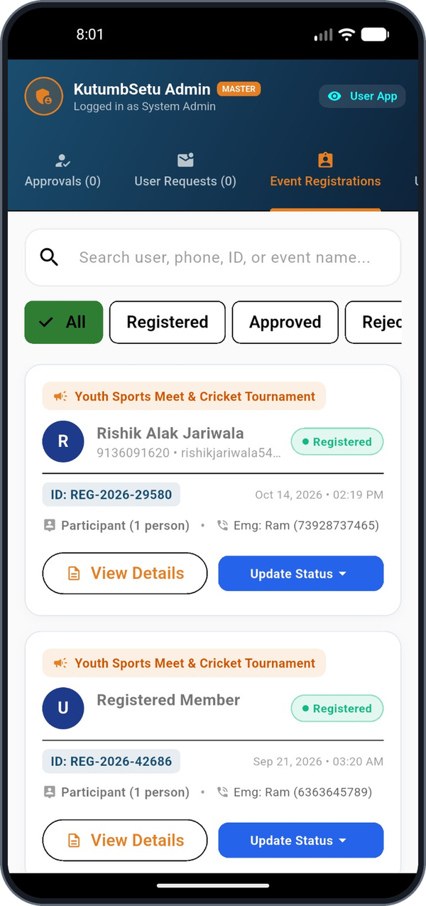
Working Prototype and Demonstration
07 | IMPLEMENTATION AND RESULTS
1 Login with email OTP
2 User registration
3 Campaign listing
4 Event registration
5 Registration ID issued
6 Admin: manage entries
Verified end to end: registration REG-2026-29580 was created in the user app and appeared in the admin console with status 'Registered'.

Slide 9
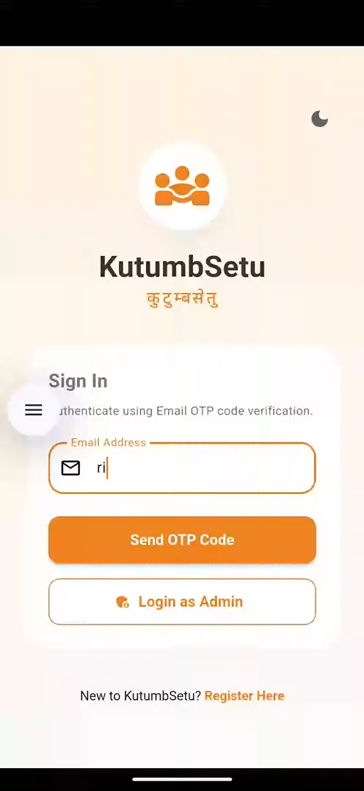
Sample Video Demonstration

Slide 10
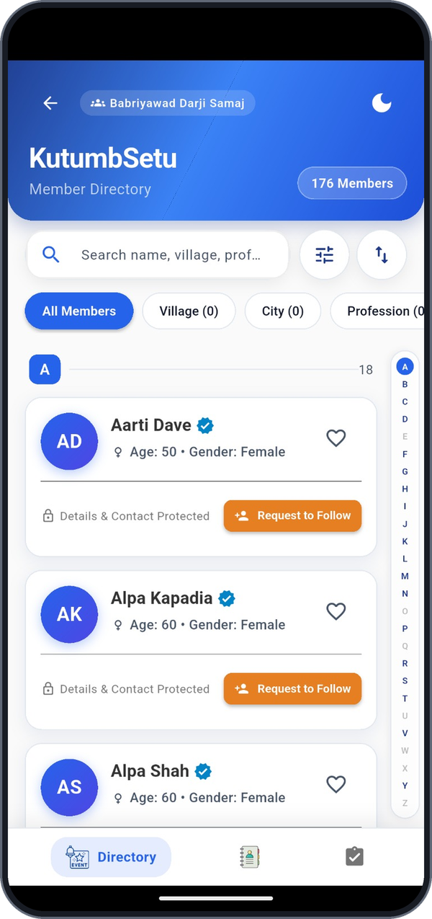
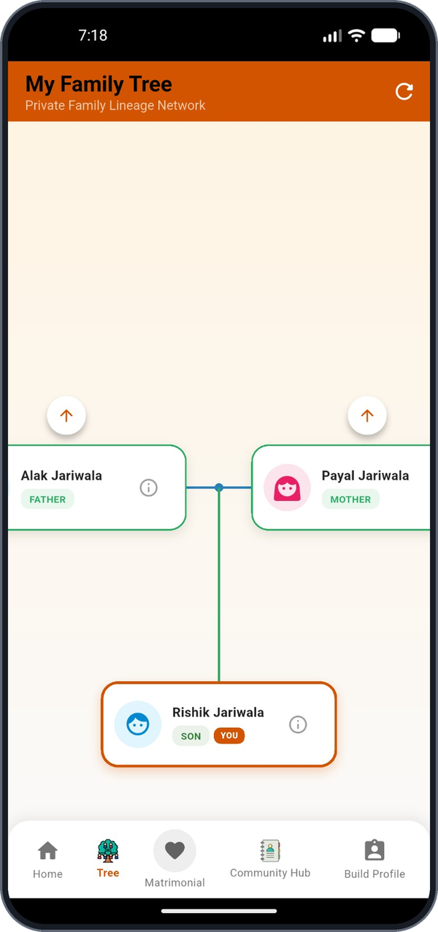







Building Better-Connected Communities
IMPACT, FUTURE SCOPE
Expected impact
Future scope (planned)
Organised information
Members, families and events in one searchable place
Push notifications
Instant alerts for events, news and wishes
Online maintenance payments
Pay dues and donations inside the app
Easier participation
Register for events in a few taps and get a unique ID
Complaint tracking
Raise issues and follow them to resolution
Better record management
Accurate, up-to-date records the admin can review
Admin analytics
Dashboards on members, events and turnout
Member directory
Family tree
Thank You | Questions?

